Slide 1


T. C.
ANKARA UNIVERSITY
ENGINEERING FACULTY
COMPUTER ENGINEERING DEPARTMENT
AN INTRUSION DETECTION SYSTEM
FOR NEW CYBER ATTACKS
Ayça Nur VANLI
Supervisor:
Asst. Prof. Ömer Özgür TANRIÖVER

Slide 2
Schedule
GitHub Repository:
https://github.com/aycavanli/IDS
Introduction
Literature Review
Dataset: CICIDS2017
Preprocessing
Model Iterations
Results and Discussion
Future Works
Bibliography

Slide 3
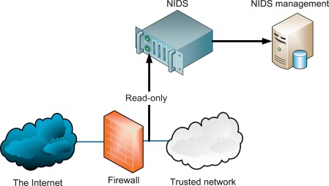


Introduction
ML
NEXT GENERATION
CYBERSECURITY DEVICES
CYBER
Notes:
Intrusion Detection System (IDS) is a commonly used device for cyber security solutions. The aim of this device is to monitor the network traffic and alert the administrator for any malicious actions in the traffic. We can classify three types of IDS based on their input data which are Network IDS (NIDS) that takes input from the network packets, Host-based IDS (HIDS) that takes input from the specific host's traffic, and Application IDS that takes input as high-risk applications traffic [1].
With the soaring expansion of the Internet over the years, every network has been facing a tremendous amount of traffic with an exponential growth rate. For this reason, it has become inevitable to abandon the traditional network IDS. This traditional approach to detecting an intrusion is called signature-based IDS where the IDS's database tries to match the actions with the already detected attacks. Hence, the industry started to consider a more intellectual way to deal with their big data and they started to improve the efficiency of their IDS. When we are considering big data like network traffic, ML algorithms can be a remedy o handle them. Therefore, machine learning algorithms can be designed to detect the bad intended traffic in a network. So, the other approach to detect an intrusion is called the anomaly-based approach where the IDS is capable to determine the obscure attacks based on abnormal behaviors.

Slide 4
Literature Review
When we search about the applicable dataset to use, one of the latest and diverse datasets is CICIDS2017. In the article called Toward Generating a New Intrusion Detection Dataset and Intrusion Traffic Characterization [1] This dataset is created by the Canadian Institute for Cybersecurity in 2017.
In the “An Efficient Feature Selection Based Bayesian and Rough set approach for intrusion detection” article [2], the study calculated the reality quality of the multiple IDS datasets using Fuzzy Logic System. They conclude that out the accuracy of the CICIDS2017 dataset to a legitimate network traffic is ~%75.

Slide 5
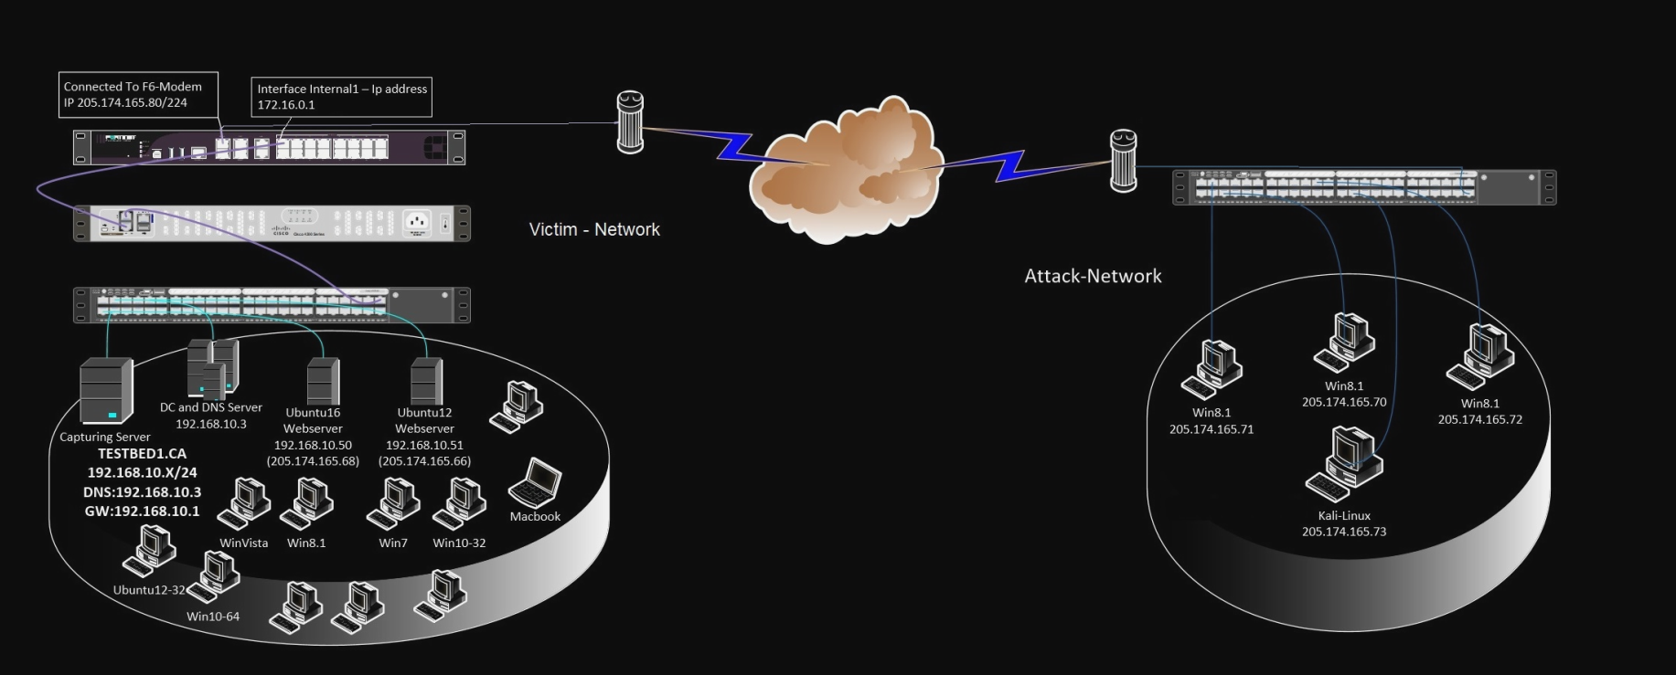
Dataset: CICIDS2017
Notes:
First, they created two kind of network. One is attacker network and the other one is the victim network. In attacker network, they have the machines that will initiate the attack towards to the victim network. The attacker network consists of some Kali computers. On the other hand, they tried to resonate the victim to the legitimate network as much as possible. Hence, they put a Domain Controller, DNS server, Windows and Ubuntu servers, Windows, Mac and Ubuntu user computers, Fortinet 2
Firewall.

Slide 6
Dataset: CICIDS2017
Notes:
Benign traffic are SSH, HTTP/S, FTP and email protocols. The attack traffic consists of 7 different attack profiles. Brute Force, Heart Bleed Attack, Botnet, DoS (Denial of Service) Attack, DDoS (Distributed Denial of Services) Attack, Web Attack, and Infiltration Attack

Slide 7
Preprocessing
Delete duplicate columns [3]
Omit empty or indefinetive cells
Define the data types of the cells
Remove any time stamps
One Hot Encoder
Scale & standardize
Aim: Help learning but keeping it real

Slide 8
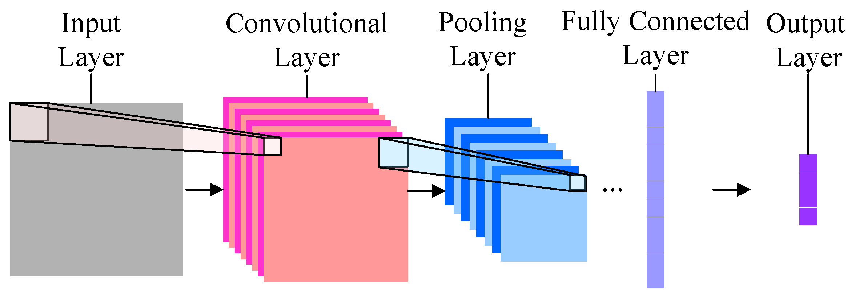
Model Iterations

Slide 9
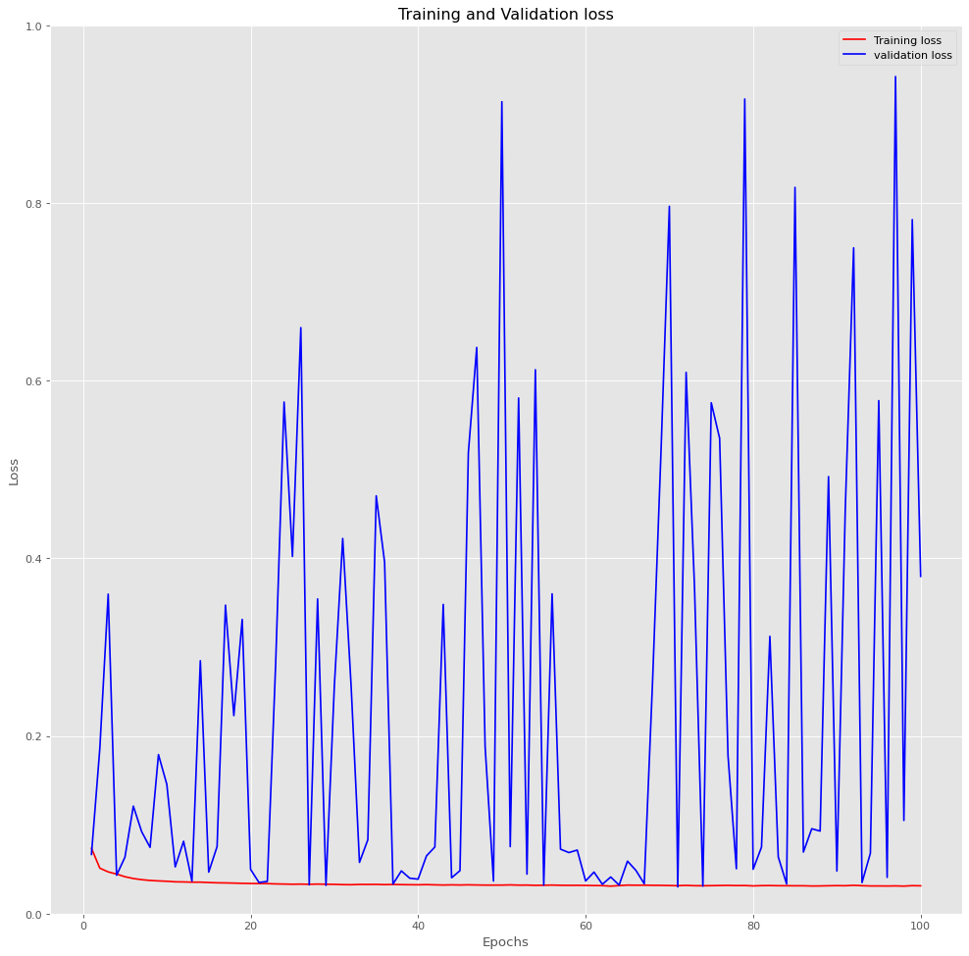
Trial # | Model | Feature Selection | Number of Features | Batch Size | Loss | Accuracy
1 | CNN | No | 70 | 256 | 0.37 | 0.8035
2 | CNN | Yes | 40 | 256 | 0.21 | 0.8810
3 | CNN | Yes | 40 | 512 | 0.23 | 0.9374
4 | CNN-BILSTM | Yes | 40 | 512 | 0.10 | 0.9753
5 | CNN-BILSTM | Yes | 10 | 512 | 1.49 | 0.8913
6 | CNN-BILSTM | Yes | 10 | 512 | 0.07 | 0.9639
Loss
Notes:
The first result I obtained was about the usage of CNN model without any feature selection which would be 70. Even if I got 80.35% accuracy for Trial #1, the loss function can be seen in the Figure 5 tell us the instability of our model.

Slide 10
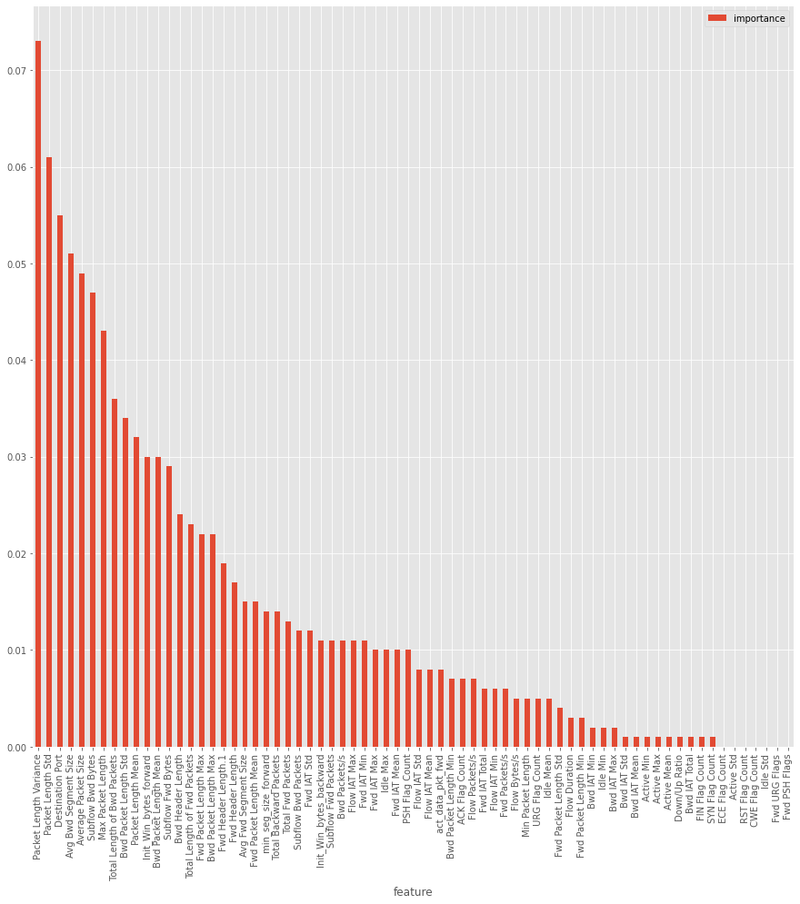
Notes:
When I run the Random Forest Classifier for to examine the importance of the 70 features, I saw a divergent number of features that can have less impact in my model. It can be seen in a descendent sorted manner in Figure 4. This encourages to do feature selection in the model. After the results, I diminished the number of features to half of the original number of features which led to 40. After trying with 40 features on trial #2, I got accuracy of 88,10%. The loss function that can be seen in the Figure 6 was better than the trial #1’s. This showed me the improvement in my model.
Figure 5:

Slide 11
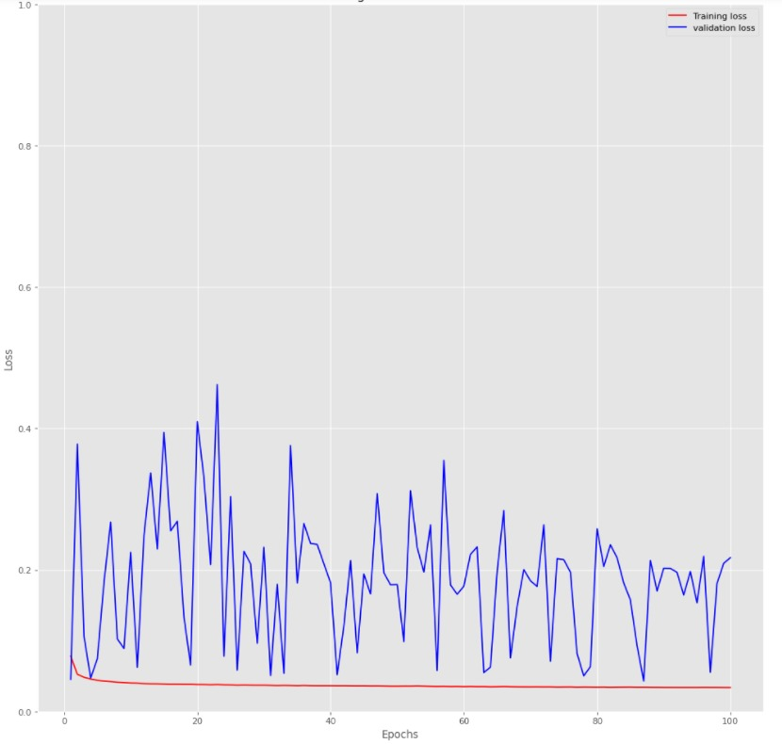
Trial # | Model | Feature Selection | Number of Features | Batch Size | Loss | Accuracy
1 | CNN | No | 70 | 256 | 0.37 | 0.8035
2 | CNN | Yes | 40 | 256 | 0.21 | 0.8810
3 | CNN | Yes | 40 | 512 | 0.23 | 0.9374
4 | CNN-BILSTM | Yes | 40 | 512 | 0.10 | 0.9753
5 | CNN-BILSTM | Yes | 10 | 512 | 1.49 | 0.8913
6 | CNN-BILSTM | Yes | 10 | 512 | 0.07 | 0.9639
Loss
Notes:
I decided to make the batch size to 512 from 256 because of the amount of time my model takes for each trial.

Slide 12
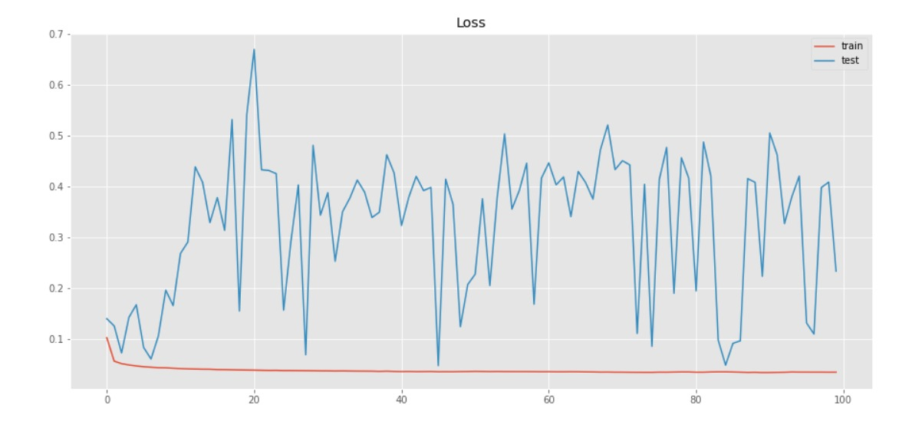
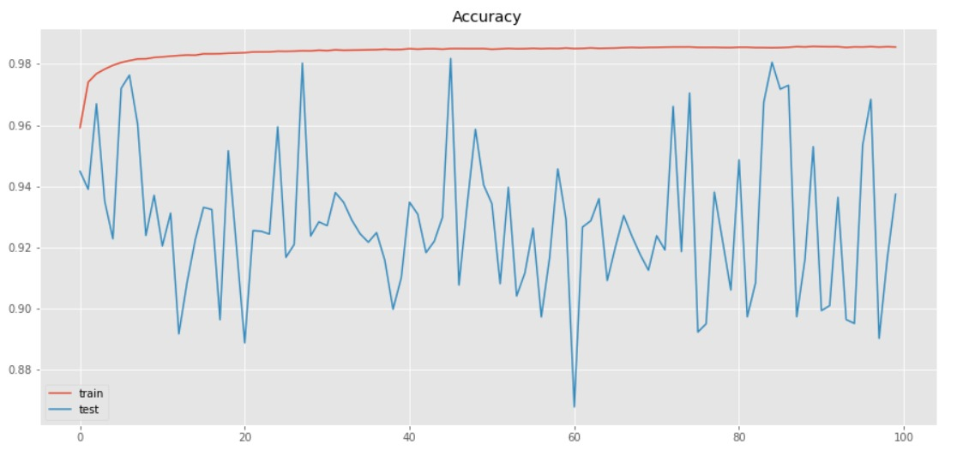
Trial # | Model | Feature Selection | Number of Features | Batch Size | Loss | Accuracy
1 | CNN | No | 70 | 256 | 0.37 | 0.8035
2 | CNN | Yes | 40 | 256 | 0.21 | 0.8810
3 | CNN | Yes | 40 | 512 | 0.23 | 0.9374
4 | CNN-BILSTM | Yes | 40 | 512 | 0.10 | 0.9753
5 | CNN-BILSTM | Yes | 10 | 512 | 1.49 | 0.8913
6 | CNN-BILSTM | Yes | 10 | 512 | 0.07 | 0.9639
Notes:
I run the model with the batch size 512 for trial #3 and I got the accuracy of 93.74%. In contrast to increase in accuracy, the loss function that can be seen in the Figure 7 was less stable than the trial #2’s. When we look at the accuracy function of the Trial #3’s that can be seen in Figure 8, we can see the harsh zig-zag in the model’s accuracy.
Because of the instable form of the CNN model, I decided to implement BILSTM layers in our CNN model.

Slide 13
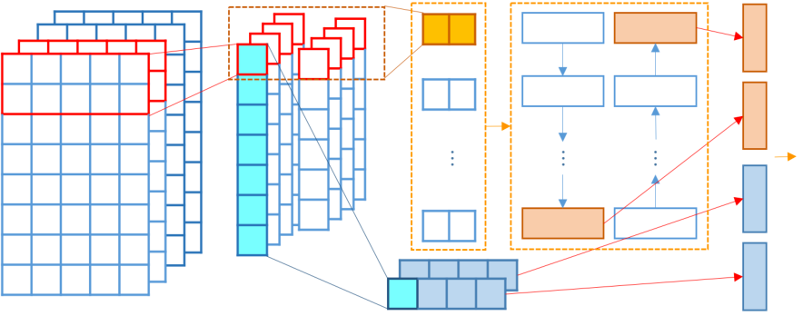
BILSTM

Slide 14
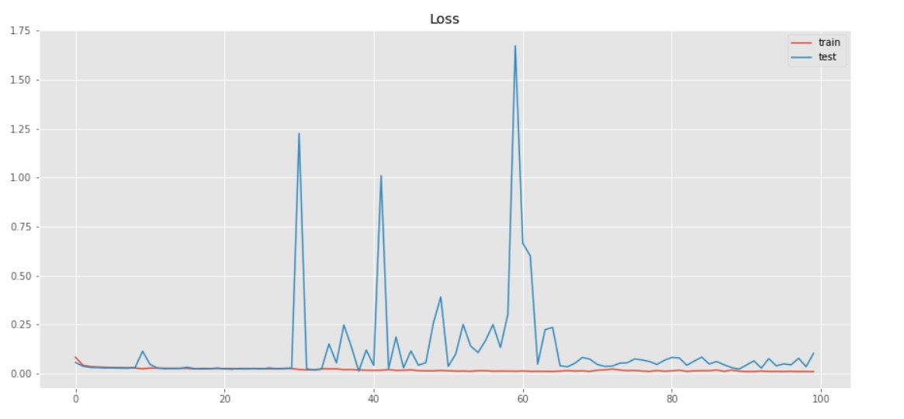
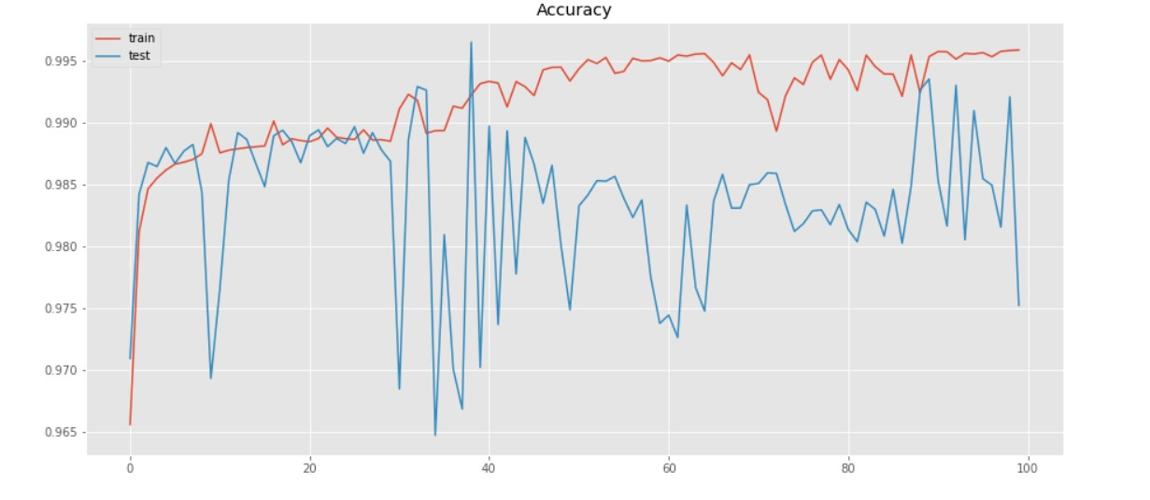
Trial # | Model | Feature Selection | Number of Features | Batch Size | Loss | Accuracy
1 | CNN | No | 70 | 256 | 0.37 | 0.8035
2 | CNN | Yes | 40 | 256 | 0.21 | 0.8810
3 | CNN | Yes | 40 | 512 | 0.23 | 0.9374
4 | CNN-BILSTM | Yes | 40 | 512 | 0.10 | 0.9753
5 | CNN-BILSTM | Yes | 10 | 512 | 1.49 | 0.8913
6 | CNN-BILSTM | Yes | 10 | 512 | 0.07 | 0.9639
Notes:
After implementing the the hybrid system, I obtained a lot more stable form of my model. The accuracy was 97,53% which was the peak in my experiment so far. The trial #4’s loss graph can be seen in the Figure 9 and the accuracy graph can be seen in the Figure 10. I decided to experiment with the number of features so I decreased the number of features from 40 to its quarter amount, 10

Slide 15
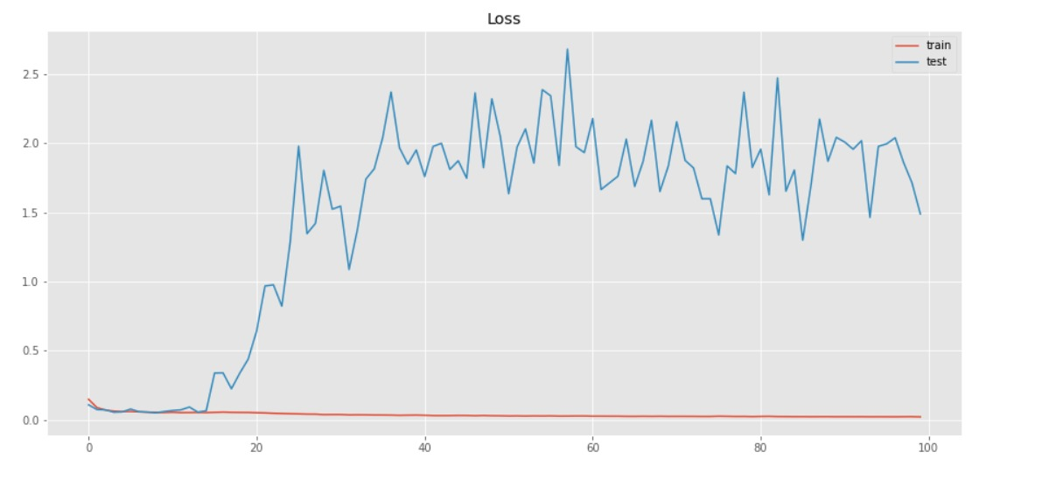
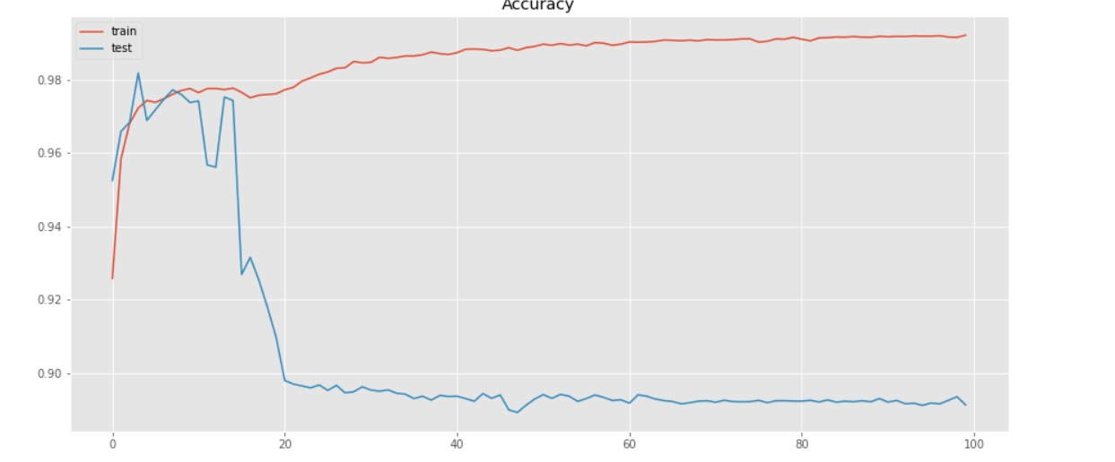
Trial # | Model | Feature Selection | Number of Features | Batch Size | Loss | Accuracy
1 | CNN | No | 70 | 256 | 0.37 | 0.8035
2 | CNN | Yes | 40 | 256 | 0.21 | 0.8810
3 | CNN | Yes | 40 | 512 | 0.23 | 0.9374
4 | CNN-BILSTM | Yes | 40 | 512 | 0.10 | 0.9753
5 | CNN-BILSTM | Yes | 10 | 512 | 1.49 | 0.8913
6 | CNN-BILSTM | Yes | 10 | 512 | 0.07 | 0.9639
Notes:
When I run the trial #5, I got much worse results than the previous trial. The loss graph that can be seen in Figure 11 was the worst loss graph in my experiment. Also, accuracy diminished from 97,53% to 89,13%. The accuracy graph can be seen in the Figure 12. Trial #5’s behaviour made me realize that I can optimize my model’s hyperparameters and structure of layers.

Slide 16
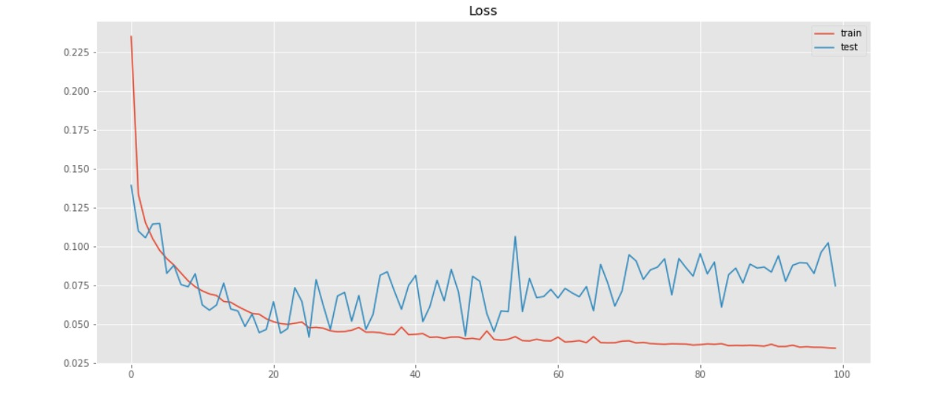
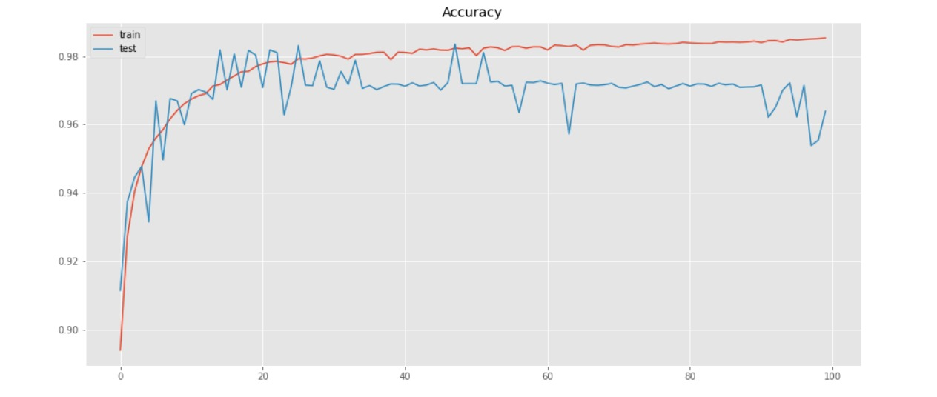
Trial # | Model | Feature Selection | Number of Features | Batch Size | Loss | Accuracy
1 | CNN | No | 70 | 256 | 0.37 | 0.8035
2 | CNN | Yes | 40 | 256 | 0.21 | 0.8810
3 | CNN | Yes | 40 | 512 | 0.23 | 0.9374
4 | CNN-BILSTM | Yes | 40 | 512 | 0.10 | 0.9753
5 | CNN-BILSTM | Yes | 10 | 512 | 1.49 | 0.8913
6 | CNN-BILSTM | Yes | 10 | 512 | 0.07 | 0.9639
Notes:
I doubled the number of convolutional layers by adding one more convolutional layer after each one. Also, I tuned the hyperparameters of the model. With these changes, trial #6’s performance sharpened increasingly. The loss graph, can be seen in the Figure 13, was more synchronized with the reality. I reached the minimum loss in the trial #6 with 0.07. The accuracy graph was a lot better too. The improvement from the previous trial were impressive with increase from 89,13% to 96,39%. The accuracy graph can be seen in the Figure 14.
Figure

Slide 17
Results and Discussion

Slide 18
Future Works
Flaws: “A detailed analysis of CICIDS2017 dataset for designing Intrusion Detection SystemCICIDS2017s – 2018” [4]
SIZE: processing time , efficiency of the algorithms.
INCOMPETENT AND REDUNDANT:
This makes harder to attain the assign accurate weights.
3. HIGH-CLASS IMBALANCE: Benign: %83.34
This creates model to be a biased towards particular class.
Remedies: “Evaluating the CICIDS-2017 Dataset Using Machine Learning Methods and Creating Multiple Predictive Models in the Statistical Computing Language R” [3]
288602 does not have a class
3119345
Heartbleed: %0.00039.
Notes:
Bunlar diyor ki evet bu dataset iyi hoş ama biz 3 tane sorun bulduk
1. Diyorlar ki output file ları çok büyük bu da hep processing time I arttıryor hem de algoritmaların efficiency’ si si azalıyor diyor
2. Bu data sette eksik ve redundant data var bu da weight atamada sıkıntı yaratıyor diyor
Bu dataset 5 günde toplanan pcap dosyalarının merge edilmiş hali ama yani çok sıkıntı olmuş
Toplamda 3119345 instance dan 288602 sinin class ı yok. 203 instance da da bilgi eksikliği varmış.
Bunlar da bu eksik dataları silmişler, zaten bunları silence de redundancy de kalmamış
3. Bu data setinde “high-class imbalance” denen sorun var bu da modelin bir class a biased olmasına sebep oluyor
Yani class lar arasında baya bi fark var
Yani benign %83.34 ile baştayken heartbleed en az ile %0.00039
Bunlar da imbalance I önlemek için atakları genelleşmişler

Slide 19
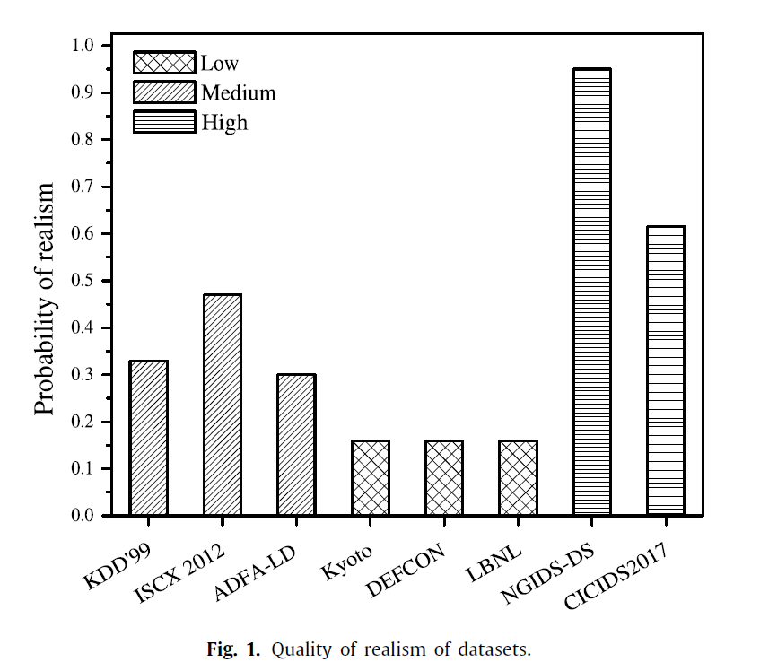
Future Works
“An Efficient Feature Selection Based Bayesian and Rough set approach for intrusion detection”[2]
NGIDS-DS(2017) → %97

Slide 20
Bibliography
[1] A. H. L. a. A. A. G. Iman Sharafaldin, "Toward Generating a New Intrusion Detection Dataset and Intrusion," in ICISSP 2018 - 4th International Conference on Information Systems Security and Privacy, 2018.
[2] S. T. a. K. D. M. Prasad, "An efficient feature selection based Bayesian and Rough set approach," Applied Soft Computing Journal, 2020.
[3] Z. Pelletier, M. Abualkibash, "Evaluating the CIC IDS-2017 Dataset Using Machine Learning Methods and Creating Multiple Predictive Models in the Statistical Computing Language R ", International Research Journal of Advanced Engineering and Science, 2020
[4] S. B. Ranjit Panigrahi, "A detailed analysis of CICIDS2017 dataset for designing Intrusion Detection Systems," International Journal of Engineering & Technology, vol. 7, no. 3.24, pp. 479-482, 2018.

Slide 21

Thank You for Listening

